Slide 1
Describing the Impact of Stress on Self-Perception of Upper Extremity Function among Women Treated for Breast Cancer
Christina Ciolek, Megan Fante, Maggie Jasper, Katie Michal, Sara Moulder, Stacey Neat, Kasi Webb, and Sarah Weyer
Faculty Mentor: Anne Fleischer, PhD., MPH, OT/L, CLT-LANA

Slide 2
In 2016, an estimated 249,260 women are projected to be diagnosed with breast cancer.
29% of all newly diagnosed female cancers
Average of 91% of women surviving breast cancer for 5 years.
(Siegel, Miller, & Jemal, 2016)

Slide 3
Recovering from the effects from breast cancer treatment and returning to life is important.
Most women recover upper body function by 18 months post-surgery for cancer.
20-40% continue to self-report swelling, loss of motion, stiffness, and pain 18-36 months after surgery.
(Hayes et al., 2012)

Slide 4
In a study of 24 women within the first year after treatment, upper extremity deficits in strength and motion explained approximately 40% of the self-reported disability scores; therefore 60% could not be explained by objective measures.
(Harrington, Padua, Battaglini, & Michener, 2013)

Slide 5
Stress has been identified as a possible reason women continue to self-report lower levels of arm function than objective measures would suggest.
(DiSipio, Hayes, Newman, Aitken, & Janda, 2010)

Slide 6
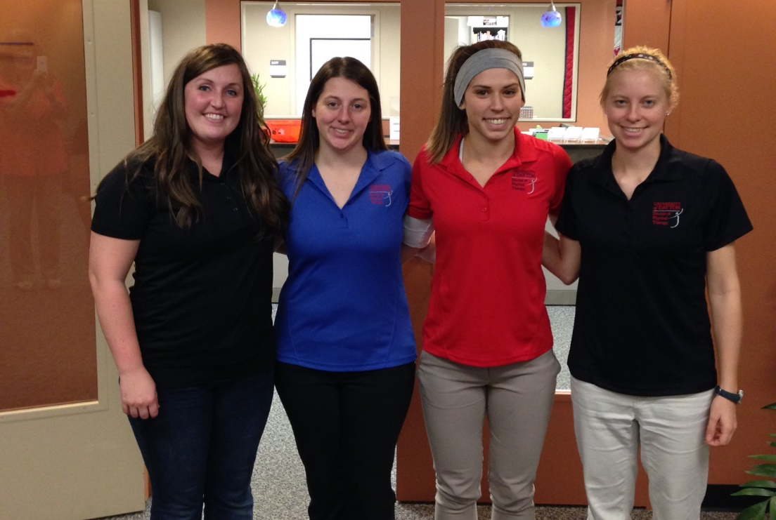
Collaboration with University of Dayton
Above: EKU inquiry team​
​
Right: University of Dayton Doctorate of Physical Therapy team​

Slide 7
Need for Pilot Study
This pilot study sought to:
evaluate the feasibility of administering the COPM over Google Hangout
evaluate the feasibility of collaborating with another research team at a distance
describe self-care, productive, and leisure activities
describe the survivor’s experiences completing self-care, productive, and leisure activities since surgery
determine if women who reported having less arm function and/or had reduced objective measures of arm function also reported higher levels of stress
Notes:
We conducted a mixed methods study and collaborated with another research team at the University of Dayton, however for the purposes of this presentation we are only focusing on elements a-d. Element e of this slide was the focus of the research team at the University of Dayton as they specifically looked at quantitative measures of the Survivors.

Slide 8
Research Questions
What self-care, productive, and leisure activities do these survivors engage in?
What was the experience completing self-care, productive, and leisure activities since surgery?
Were there differences among self-care, productive, and leisure activities between survivors 51 years or younger and those over 51 years?
Were there differences among self-care, productive, and leisure activities between survivors who received chemotherapy and those who did not?
Does stress influence a woman’s self-perception of upper extremity function?
Notes:
Again E is highlighted in red because it was more of a focus for The University of Dayton. The portion of the research that we completed and are presenting on today, however, answers the first 4 listed research questions on the slide.

Slide 9
Methodology
Cross-sectional, mixed methods study that included 23 survivors
Recruitment: word of mouth, fliers, breast cancer support groups, physicians, and breast cancer clinics in Dayton, Ohio by a professor at the University of Dayton’s physical therapy department
Notes:
This cross-sectional mixed method study included 25 participants. One of the 25 was excluded because she had Stage IV breast cancer. During a single visit, participants’ medical and social history, self-reported upper body function and stress levels were evaluated using questionnaires. Upper body physical functioning was assessed through range of motion, strength, and endurance measures. Perceived satisfaction and performance of occupational performance problems, and the types of self-care, productive and leisure activities were described using the COPM.
Participants were recruited via word of mouth, fliers, breast cancer support groups, physicians, and breast cancer clinic in Dayton, Ohio by a professor at the University of Dayton’s physical therapy department.

Slide 10
Inclusion Criteria
• Diagnosis of breast cancer (unilateral or
bilateral) between 12-60 months
before enrollment
• Stage 0-3 breast cancer
Received surgery for cancer
• Reads and understands English
Notes:
Inclusion criteria were selected to understand the impact of breast surgery on perceived and actual upper body function.

Slide 11
Exclusion Criteria
Metastatic breast cancer
Past shoulder injury
Shoulder, neck, and/or chest surgery
Cognitive deficits
Recurrence of cancer
Cardiovascular contraindications
Non-English speaking
Notes:
Exclusion criteria attempted to eliminate confounding variables, which would negatively influence perceived or actual upper body function.

Slide 12
Informed Consent
The informed consent was reviewed with each survivor by physical therapy student.
After the survivor consented to participate, she began the study at any available station.
Notes:
Before initiating the study, the informed consent was reviewed with each participant, which included any potential risks. After the survivor consented to participate, she began the study at any available station.

Slide 13
Station 1: Surveys
DASH: describes ability to use arm on side of breast cancer treatment
FACT-B: describes breast cancer influence on daily activity and interaction with other people
Perceived Stress Scale: describes current stress level
Fear of Physical Activity/Exercise Scale – Breast Cancer: describes how they feel about movement and activity
Notes:
*Say that we aren’t presenting specifically on this data
Station 1 consisted of the following surveys and was supervised by a University of Dayton student who provided instructions on how to complete surveys.
Disabilities of the Arm, Shoulder, & Hand (DASH)
Functional Assessment of Cancer Therapy (FACT-B)
Perceived Stress Scale
Fear of Physical Activity/Exercise Scale- Breast Cancer

Slide 14
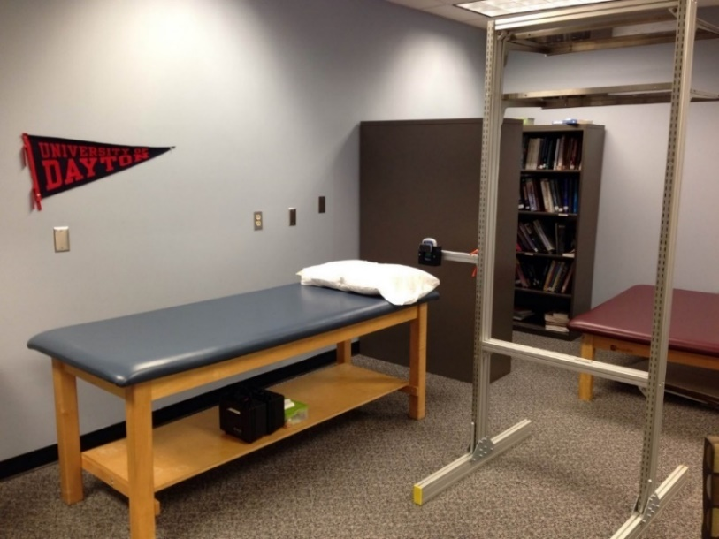
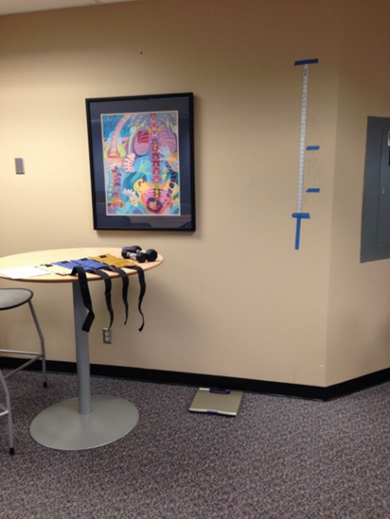
Station 2: Physical Measures
Strength- measured using a dynamometer
Range of Motion- arm flexion measured in standing and internal/external rotation measured in supine
Endurance- measured during weighted arm flexion
Height and Weight- measured using a meter stick and scale
Notes:
Strength: Strength measures were taken using a dynamometer attached to a metal stand; each subject had two attempts to provide maximal effort over a period of 5 seconds by pressing into the device. The peak force was recorded for each trial and averaged. Arm flexion measurements were taken in standing, while internal/external rotation measurements were taken in supine.
ROM: Flexion measures were taken using a goniometer; each subject had two attempts to reach maximum range of motion; the measurements were then recorded and averaged. Arm flexion measurements were taken in standing, while shoulder internal/external rotation measurements were taken in supine.
Endurance: Arm endurance was measured during weighted arm flexion. Subjects were asked to hold their arm straight out at shoulder level with a weight on the end (using dumbbells/ankle weights which was determined based on body weight), and raise the weight to a height of 10 inches above shoulder level, then return to shoulder level. A metronome was set to 40 bpm. Subjects were instructed to move their arm between the two points maintaining the beat as long as they could, or until they reached 20 reps, which determined the rate of perceived exertion. The endurance measures were only done once for each arm.
Height and weight: were measured using a meter stick and scale.

Slide 15
Station 3: Interview
Canadian Occupational Performance Measure (COPM)
Self-perception of satisfaction and performance of everyday life occupations
Administered via Google Hangout
Notes:
The COPM was conducted via Google Hangout by Eastern Kentucky University occupational therapy Master’s students.

Slide 16
Breast cancer stages
Notes:
This chart illustrates the different stages of breast cancer.
In stage 0, abnormal cells are beginning to develop in the lining of the ducts or sections of the breast. The rate of survival for this stage is 100%.
In stage 1, cancer has moved out of the lining of the ducts into the breast tissue, tumor is less than 1 inch across. The survival rate for stage 1 is 98%.
In stage 2, tumor is less than 2 inches across and has spread to at least one axillary lymph node. The likelihood of survival is 88%.
In stage 3, tumor is larger than 2 inches across with extensive spread to regional lymph nodes. The survival rate for stage 3 is 52%.
Lastly, in stage 4, the cancer has spread beyond the breast to other parts of the body. The rate of survival is 16%.

Slide 17
Breast cancer types
Notes:
There are four main types of breast cancer:
Ductal carcinoma in situ, or DCIS, means that cancer cells have begun to develop in the ducts of the breast. (Stage 0)
Lobular carcinoma in situ, or LCIS, means that abnormal cells have begun to develop in the milk-producing glands (or lobules)of the breast. (Stage 0)
Invasive ductal carcinoma, or IDC, is cancer that began growing in the duct and has invaded the surrounding breast tissue. IDC is the most common type of breast cancer.
Invasive lobular carcinoma, or ILC, is a type of breast cancer that begins in the lobules of the breast and spreads beyond it. About 10-15% of breast cancers diagnosed are invasive lobular carcinoma.

Slide 18
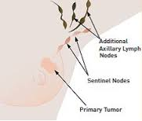
Lymph node biopsy
Axillary lymph node dissection
Sentinel lymph node dissection
Notes:
A sentinel lymph node biopsy is a procedure in which the sentinel lymph node is identified, removed, and examined to determine whether cancer cells are present.
A sentinel lymph node is defined as the first lymph node to which cancer cells are most likely to spread from a primary tumor.
A negative SLNB result suggests that cancer has not developed the ability to spread to nearby lymph nodes or other organs. A positive SLNB result indicates that cancer is present in the sentinel lymph node and may be present in other nearby lymph nodes or other organs. This information can help determine the stage of cancer (extent of the disease within the body).
Axillary node dissection removes some of the axillary lymph nodes, which are the lymph nodes located in the underarm. Once removed, they are dissected and examined.
Evaluation of the axilla provides information for treatment decisions in patients with invasive breast cancer.

Slide 19
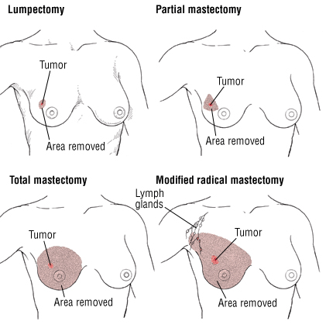
Breast surgery
Notes:
This slide illustrates the various types of breast surgery. The top left shows a lumpectomy which is the removal of abnormal or cancerous tissue. The top right shows a partial mastectomy which is removal of the tumor as well as some tissue around it. The bottom left shows a total mastectomy which removes the breast tissue, nipple, areola and skin but not all the lymph nodes, the modified radical mastectomy, incudes removal entire breast, including the skin, areola, nipple, and most axillary lymph nodes

Slide 20
Radiation therapy
Notes:
This image shows different radiation therapies. The top images show external beam radiation, which as you can see, is an external beam to a selected area where there may be remaining abnormal tissue. The bottom image shows internal radiation which is when radioactive materials are placed inside affected area. Radiation directly to cancerous area.

Slide 21
Chemotherapy Induced Peripheral Neuropathy
Pain (which may be there all the time or come and go, like shooting or stabbing pain)
Burning
Tingling (“pins and needles” feeling) or electric/shock-like pain
Loss of feeling (which can be numbness or just less ability to sense pressure, touch, heat, or cold)
Trouble using your fingers to pick up or hold things; dropping things
Balance problems
Trouble with tripping or stumbling while walking
Being more sensitive to cold or heat
Being more sensitive to touch or pressure
Shrinking muscles and/or muscle weakness
Trouble swallowing
Constipation
Trouble passing urine
Blood pressure changes
Decreased or no reflexes
Notes:
Chemotherapy-induced peripheral neuropathy, or CIPN, is damage to the peripheral nerves due to chemotherapy. Symptoms include...

Slide 22
Description of survivors

Slide 23
Stage of Cancer
Notes:
This graph shows the distribution of Survivors’ stage of cancer.
Most of the Survivors had Stage 1, 2 or 3 cancer

Slide 24
Types of Breast Cancer
Notes:
Women who had more advanced cancer were more likely to also have received chemotherapy.

Slide 25
Type of Surgery
9
14
Notes:
More women in this sample surgically had a mastectomy.

Slide 26
Chemo vs. Non Chemo Survivors
Notes:
Sample had slightly more women who received chemotherapy.

Slide 27
Notes:
This graph represents the distribution of Survivors who experienced chemo-induced peripheral neuropathy in Survivors. The majority of our Survivors were not experiencing this.
CIPN: Tingling sensation typically in the fingertips & feet that can cause pain/numbness.
Taxol: neurotoxic chemo which can cause CIPN. Frequently temporary.

Slide 28
Comparison of survivors who were ≤ 51 yrs. and >51 yrs.

Slide 29
Comparison of demographics, survey results and range of motion
Notes:
The demographics, survey results, and musculoskeletal differences were not significant for the two age groups.

Slide 30
Comparison of work status and cancer characteristics
Notes:
The information presented in this chart indicates that the Survivors that were 51 years or younger worked more than the Survivors that were older than 51 years old.

Slide 31
Comparison of stage, treatment and CIPN
Notes:
The information presented in this chart indicates that the majority of the Survivors that were older than 51 did not have chemo-induced peripheral neuropathy. It also indicates that the Survivors that were 51 years old or younger received more treatments, such as: mastectomies, neurotoxic chemotherapies, and full lymph node dissections. This is reflected in the fact that they had more Stage II and Stage III breast cancer than the Survivors that were older than 51 years old. These Survivors (the Survivors over the age of 51) had more Stage I and Stage II breast cancer.

Slide 32
Comparison of survivors who had chemotherapy and those who did not receive chemotherapy

Slide 33
Demographics: Chemo vs. Non-Chemo
Notes:
This graph indicates that age served as a confounder in this study.
More younger women received chemotherapy than older women. Therefore, the chemotherapy group had greater range of motion because younger women tend to have less range of motion restrictions.

Slide 34
Notes:
This graph also reflects the fact that there were more younger women in the chemotherapy group. More younger women were working, while older women were retired or not working.

Slide 35
Demographics: Chemo vs. Non-Chemo
Notes:
This graph shows that participants with stage 0 or stage I breast cancer received less chemotherapy treatment than those with more advanced stages (II and III).
All participants with stage III cancer received chemotherapy.
Participants who were not receiving chemotherapy had more lumpectomies, mastectomies, and sentinel lymph node dissections, while those undergoing chemotherapy received more axillary node dissections and radiation.
Only those participants receiving chemotherapy experienced chemotherapy-induced peripheral neuropathy. However, not all participants in the chemotherapy group experienced CIPN.

Slide 36
Self-Care

Slide 37
Self-Care
Notes:
We reviewed the list of self care activities provided and categorized them into being either solitary or non-solitary. We counted the number of self care activities mentioned that fit into each of these categories.
Most of the self-care activities listed by the Survivors were solitary. There was not a difference between age groups nor those who received chemotherapy and those who did not.

Slide 38
Productivity

Slide 39
Productivity
Notes:
We reviewed the productive activities mentioned and categorized them by household chores, outdoors, paid, virtual/online, helping others for each of the 4 groups. We counted the total number mentioned by the Survivors within each category and graphed it.
Household chores were mentioned the most among all four groups.
Survivors who received chemotherapy or were 51 years or younger mentioned paid work more frequently than those who did not receive chemotherapy or were over 51 years of age.

Slide 40
Leisure

Slide 41
Leisure
Notes:
We reviewed the leisure activities listed by the Survivors and sorted them into the following categories: outdoor, relaxing, socialization, sedentary, exercise, & religious.
Based on this graph, exercise was of high importance to 2/4 groups (the chemo and 51 yrs and younger group), and socialization was of high importance to the other 2/4 groups (non-chemo and the over 51 yrs group).
Relaxing, being outdoors, and participating in religious activities are the least important for all 4 groups.

Slide 42
Survivors’ comments during and after administering the COPM
Notes:
At the end of administering the COPM As a group, we each reviewed our individual COPMs that we or another team member administered.

Slide 43
Qualitative Analysis
While recording the COPM scores, each administrator wrote down any comments that the Survivors made.
The administrators asked each Survivor the following at the end of the assessment, “Is there anything that you would like to add about completing your daily activities that I have not asked that you would like to share?” The survivor’s response was recorded

Slide 44
Each researcher examined the notes taken during the COPM.
Collectively, the researchers organized the statements into a category if similar statements were found in at least four survivors comments.

Slide 45
Psychological Distress
Survivor stated her past 9 years have been very rough and when asked what she does for leisure or fun the client stated "I haven't had too much fun these past 9 years” (BC21).

Slide 46
Side Effects

Slide 47
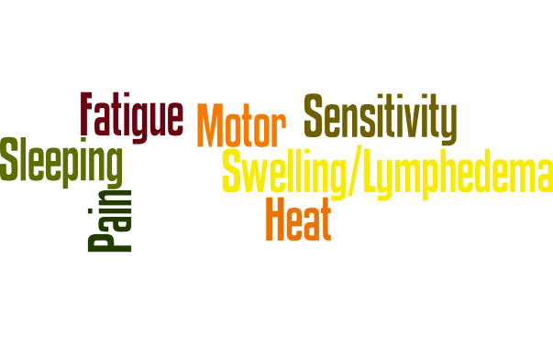
Side Effects
Notes:
There were common side effects reported in comments during and after the COPM.

Slide 48
Heat Sensitivity
She did mention she gets fatigued which affects her ability to walk for long periods of time especially outside because the heat and humidity bother her since treatment (BC17).

Slide 49
Numbness/Fine Motor
She stated that she has numbness within her right arm which makes handling keys hard which is a significant function of her job as she is opening and closing doors all day (BC22).

Slide 50
Sleep Disturbance
Cannot sleep on left side due to lymphedema. Cannot sleep on stomach since double mastectomy. Wakes up frequently during the night. Difficulty sleeping on her back. Does not feel rested in the morning (BC5).
Has difficulty sleeping through the night due to pain and throbbing in her chest. Does not feel rested when she wakes up in the morning (BC12).

Slide 51
Fatigue
She brings a chair to her garden so she can rest every 45 to 60 minutes” (BC15).
Vacuuming/Dusting- Cannot clean the whole house like she used to do; she cleans one room at a time...she gets frustrated due to her lack of endurance (BC9).
Survivor stated that the medicine regime and chemo/radiation that she is currently on makes her very fatigued (BC22).

Slide 52
Swelling/Lymphedema
Cannot sleep on left side due to lymphedema. [BC5]
She is very frustrated that she is unable to sleep through the night due to the discomfort from her lymphedema. She has to position her arm in a certain way (BC2).

Slide 53
Performance Factors

Slide 54
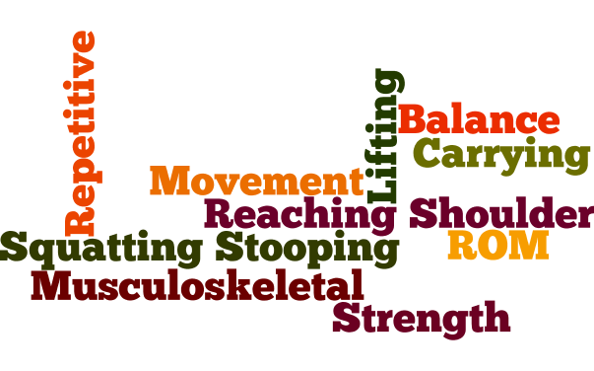
Performance Factors
Notes:
These were the performance factors that women discussed having difficulties with before and after the COPM. The women reported having more performance factors problems than side effects. Next, we will discuss some of the comments that we feel depict some of the words in this picture well.

Slide 55
Squatting/Stooping
She can't get up off the floor, stoop or bend (BC15).
Survivor stated that she cannot bend or twist her trunk nor can she squat (BC22).

Slide 56
Strength
Realized how heavy a gallon of milk was (BC11).
Has difficulty opening jars and often asks her husband or sons to help her (BC20).

Slide 57
Repetitive Movement
She reports that her 1st thought when she initiates an activity is "Will this trigger lymphedema?" This is why she is afraid to swim any longer than she currently does [because this include repetitive arm movements] (BC1).

Slide 58
Balance
Unable to go cycling due to decreased balance (BC8).
She has a difficult time performing the different yoga poses because her balance has slightly worsened since her surgery. Her decreased balance has also caused her to have some difficulties getting dressed in the morning (BC18).

Slide 59
Reaching/Shoulder ROM
Putting dishes on shelves- Uses a step stool to help her (BC9).
Doing laundry- Uses a reacher to get clothes from the bottom of the washer as it is difficult to get them without the reacher (BC9).
Restricted when drying hair and reaching in cabinets (BC10).

Slide 60
Lifting
At work her performance was scored lower because she can no longer lift boxes due to inability to lift heavy objects and she fatigues, so she no longer does this task at work (BC17).

Slide 61
Carrying
Unable to carry heavy grocery bags and heavy loads of laundry, so she makes her loads lighter (BC12).
She can't carry things. She could not help her daughter move into college which was very upsetting to her (BC15).

Slide 62
Personal Choices

Slide 63
PERSONAL
CHOISES
Notes:
These were the personal choices that women made before and after the COPM. Next, we will discuss some of the comments that we feel depict some of the words in this picture well.

Slide 64
Socializing
Enjoys taking care of 5 month old grandchild, watching grandchildren play soccer, going to the movies, going out to eat with friends, and shopping at flea markets (BC8).
Enjoys shopping at antique stores, visiting with friends and family, and cooking and eating with her husband and two sons every day (BC20).

Slide 65
Exercise
Cannot do as many push-ups and complete arm workouts as before due to arm restrictions (BC5).
Survivor stated that she has difficulties running on the elliptical because her endurance levels seem to have decreased since her surgery (BC18).
She feels that doing exercise has a great deal to do with the reason that she regained her arm function (BC6).

Slide 66
Strengths
Data were audited by students and investigators
Standardized and qualitative data were used
Study conducted with physical therapy students from University of Dayton
Inclusion criteria included survivors who had surgery for their cancer, which has been found to impact upper body function

Slide 67
Strengths Continued…
Informed consent was reviewed with each survivor prior to participating in study
All data was de-identified and only accessible by investigators
COPM was administered using a script
Prior to administering to survivors, each OT student provided the COPM to the investigator to improve inter-rater reliability

Slide 68
Weaknesses
Age range of survivors was 31 yrs. to 68 yrs., which reflect diverse developmental stages
Administered the COPM to survivors who were greater than 18 months post-surgery (survivors ranged from 5-55 months post surgery)
Administered COPM over Google Hangout, which is not a standardized method

Slide 69
Weaknesses Continued…
Heterogeneous population (some survivors received different surgeries, various types of chemotherapy, and/or different amounts and locations of radiation therapy)
All data were entered by multiple people

Slide 70
Clinical Take-home
Research Questions A) Evaluate the feasibility of administering the COPM over Google Hangout
Felt as if in person
Emotions were evoked
Natural responses
Wi-Fi was critical

Slide 71
Clinical Take-home
Research Questions
B) Evaluate the feasibility of collaboration with another research team at a distance.
Collaboration possible due to technology: text messaging, email, Google Hangout
Issues remain the same: scheduling of participants

Slide 72
Clinical Take-home
Research Questions
C) Describe self-care, productive, and leisure activities
Changed routine: most energy demanding tasks-earlier
Process: step stool to reach higher
Role adjustment: accepting help from others
Modifying job duties: more sedentary duties

Slide 73
Clinical Take-home
Research Questions
D) What were survivors experiences of completing activities since surgery?
Physical challenges/side effects: Pain, sleep disturbances
Emotional: Awareness of priorities such as family
Variety of perspectives: Not enjoying life vs. Refusing to look at negative side

Slide 74
Clinical Take-home
Questions OTs should ask survivors
1. What is important for you to get back to doing?
2. Why are you unable to do it as you would like to do it?
Notes:
After completing the study, we thought of questions we would like to have explored more such as…

Slide 75
Clinical Take-home
Recommendations
Build rapport: Allowing them to tell their story
Understand types, stages, and treatments of breast cancer
Recognize the connection between side effects and possible functional challenges
Recognize each experience is still different
Notes:
After completing the study, we also thought of advice we would like to give to others who would take part in this study or studies similar to this.

Slide 76
Questions

